Slide 1


Toure Mohamed Ali
14.06.2024

Slide 2


Outline
Executive Summary
Introduction
Methodology
Resultats
Conclusion
Appendix

Slide 3
Executive Summary
Summary of methodologies
Data Collection
Data Wrangling
EDA with Data Visualization with matplotlib and co
EDA with SQL
Interactive map with Folium
Dashboard with Dash Plotly
Perform predictive analysis using divers' plot
Summary of all results
EDA resultat
Interactive analysis
Predictive analysis

Slide 4

Introduction
Project background and context
SpaceX advertises Falcon 9 rocket launches on its website with a cost of 62 million dollars; other providers cost upwards of 165 million dollars each, much of the savings is because SpaceX can reuse the first stage
Problems you want to find answers
If SpaceX will reuse the first stage. Instead of using rocket science to determine if the first stage will land successfully​ ??

Slide 5

Section 1

Slide 6

Methodology
Executive Summary
Data collection methodology:
Data was collected thought the SpaceX Api, Website ,Wikipedia
Web Scraping using Beatifullsoup
Parsing , Filtering and Cleaning
Perform data wrangling
Data cleaning through removing some irrelevant feature ,columns and, missing data/null values
Encoding some categorical value into numerical value and perform data normalization for value scaling
Perform exploratory data analysis (EDA) using visualization and SQL
Perform interactive visual analytics using Folium and Plotly Dash
Perform predictive analysis using classification models
Linear Regression(LR) ,Support Vector Machine(SVM) ,K-Nearest Neighbors(KNN),Decision Tree(DT)

Slide 7
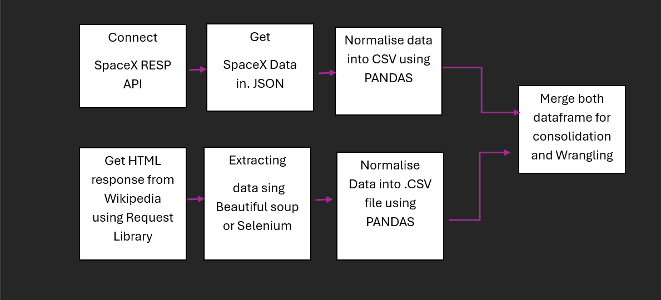
Data Collection
SpaceX launch data that is gathered from the REST API
The collected data give us some pretty information about launches like payload ,used rocket, launchpad ,launch and landing specification etc..
Wikipedia Webscraping to get some extra information about the Falcon 9

Slide 8
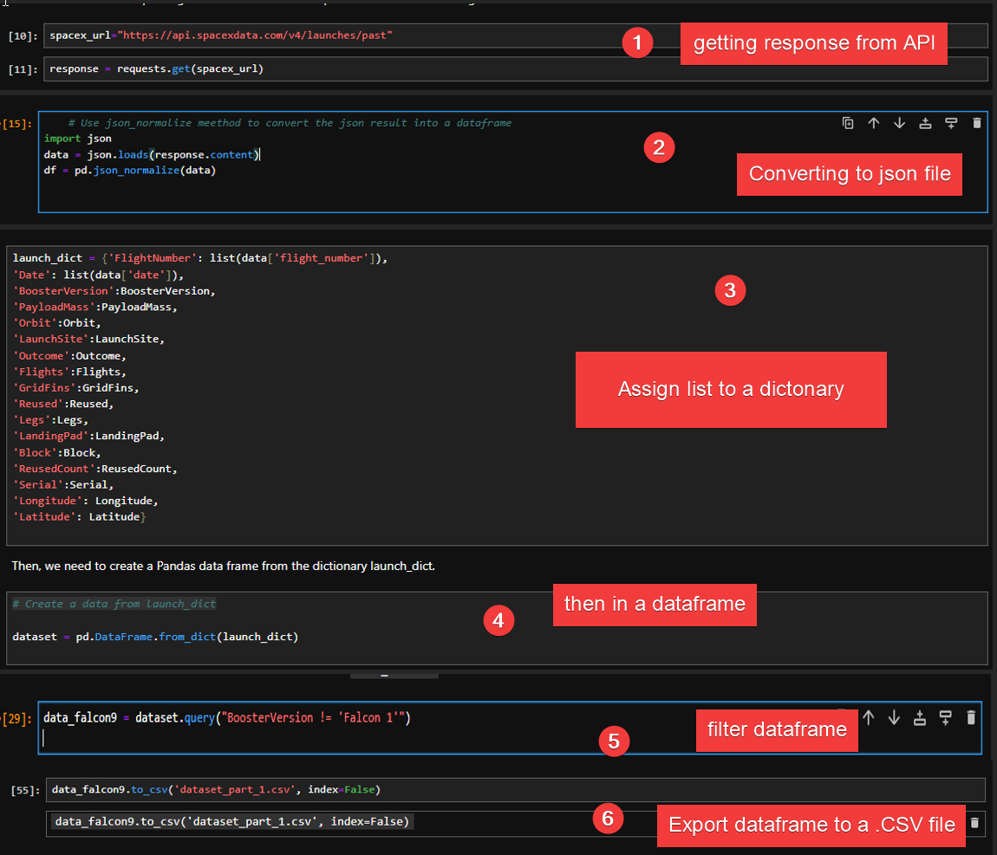
Data Collection – SpaceX API
Data collection with SpaceX REST calls
https://github.com/YmClash/SpaceY/blob/master/JUPYTER/jupyter-labs-spacex-data-collection-api.ipynb

Slide 9
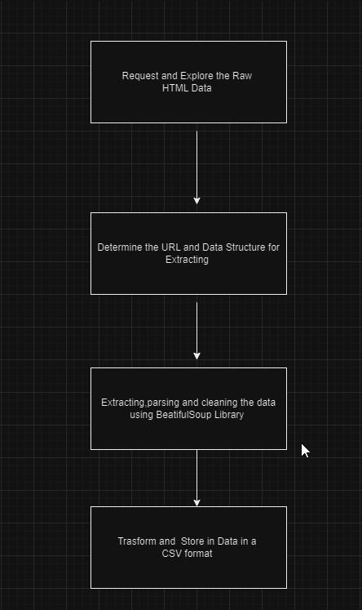
Data Collection - Scraping
https://github.com/YmClash/SpaceY/blob/master/JUPYTER/jupyter-labs-webscraping.ipynb

Slide 10
Data Wrangling
Check null values
Calculate the number of Launches on each site
Calculate the number and occurrence of each orbit
Handle null values
Create a landing outcome label from Outcome Column
Calculate the number and occurrence of mission outcome per orbit type
https://github.com/YmClash/SpaceY/blob/master/JUPYTER/labs-jupyter-spacex-Data%20wrangling.ipynb

Slide 11
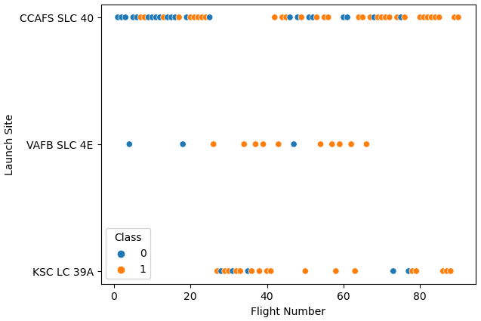
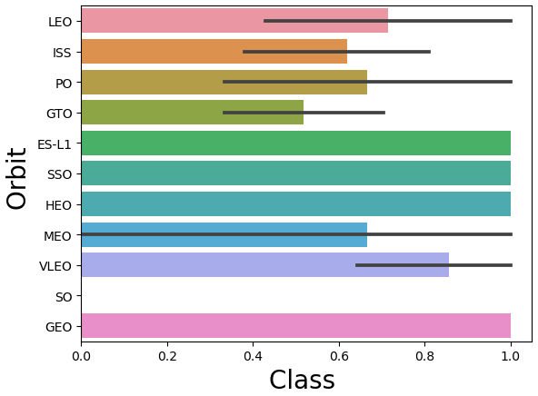
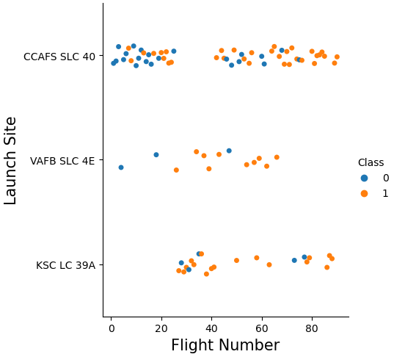
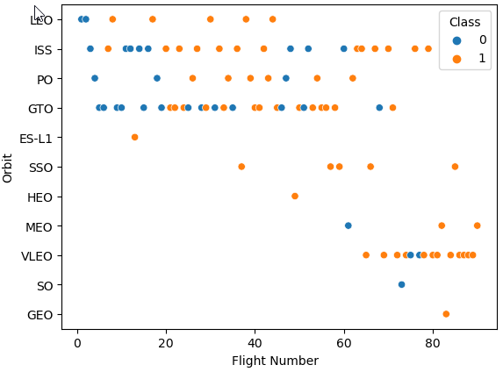
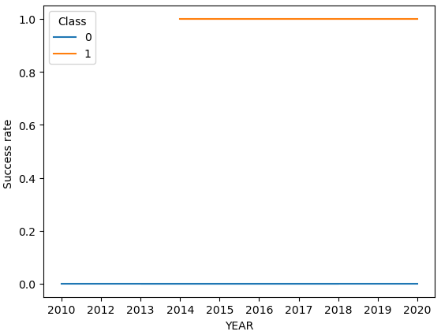
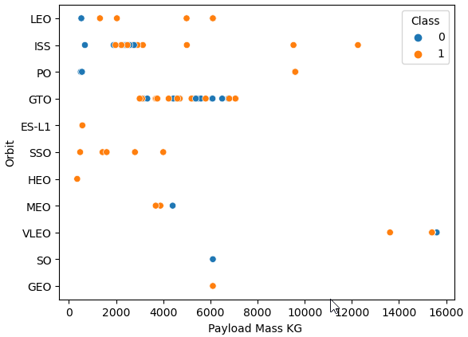
EDA with Data Visualization
https://github.com/YmClash/SpaceY/blob/master/JUPYTER/jupyter-labs-eda-dataviz.ipynb

Slide 12

EDA with SQL
SQL queries performed in the database
Display the names of the unique launch sites in the space mission
Display 5 records where launch sites begin with the string 'CCA’
Display the total payload mass carried by boosters launched by NASA (CRS)
Display average payload mass carried by booster version F9 v1.1
Listing the date when the first successful landing outcome in ground pad was achieved.
Listing the names of the boosters which have success in drone ship and have payload mass greater than 4000 but less than 6000
Listing the total number of successful and failure mission outcomes
Listing the names of the booster versions which have carried the maximum payload mass
Listing the records which will display the month names, successful landing outcomes in ground pad ,booster version ,launch site for the months in year 2017
Ranking the count of successful landing outcomes between the date 04/06/2010 and 20/03/2017
https://github.com/YmClash/SpaceY/blob/master/JUPYTER/jupyter-labs-eda-sql-coursera_sqllite.ipynb

Slide 13

Build an Interactive Map with Folium
Map markers have been added to the map with aim to find an optimal launch site location for building a launch site
https://github.com/YmClash/SpaceY/blob/master/JUPYTER/lab_jupyter_launch_site_location.ipynb

Slide 14
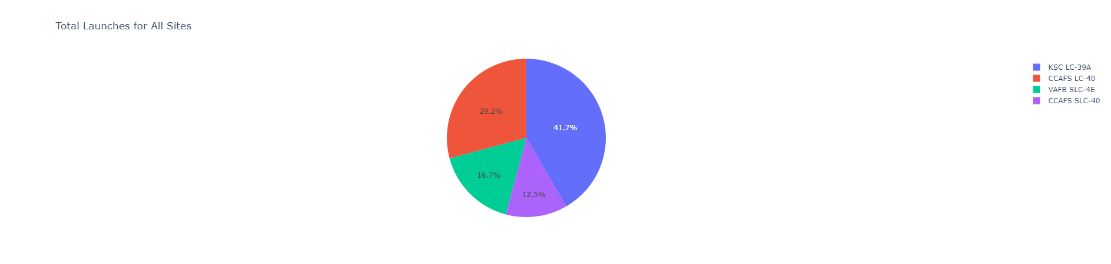
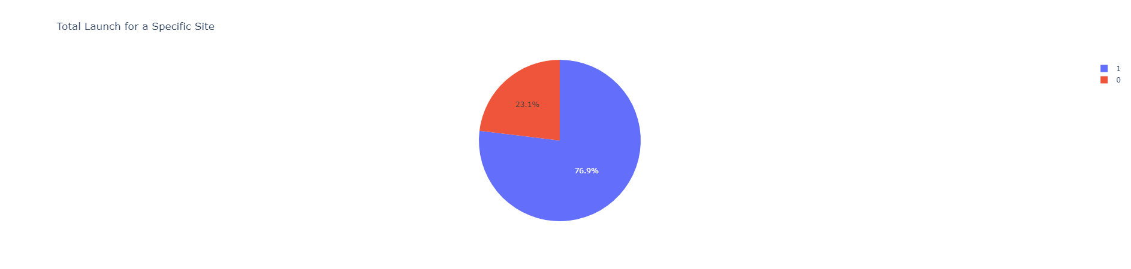
Build a Dashboard with Plotly Dash
KSC LC-39A is the best launch site with 41,7% succes
KSC LC-39A as 76,9% success rate while other just 23,1% failure rate
https://github.com/YmClash/SpaceY/blob/master/lab_1.py

Slide 15
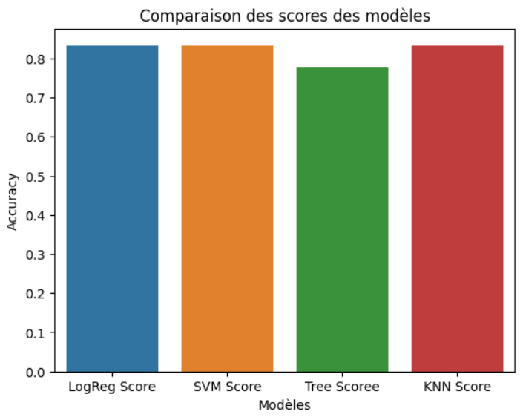
Predictive Analysis (Classification)
The Logistic Regression, SVM and the KNN model achieved the Highest accuracy with 83,3% while the SVM perform the best in terms of Area
https://github.com/YmClash/SpaceY/blob/master/JUPYTER/SpaceX_Machine_Learning_Prediction_Part_5.jupyterlite.ipynb

Slide 16

Resulats
SVM,KNN and logistic Regression model perform the best prediction accuracy on this dataset
Low weighted payloads perform better than the heavier payload
The success rates for SpaceX launches is directly proportional time in years they will eventually perfect the Launches edit : In June 2024 SpaceX success for the first time to brought the superheavy in Orbit
KSC LC 39A hat the most successful launches from all the sites
Orbit GEO,HEO,SSO,ES L1 has the best success rate

Slide 17

Section 2

Slide 18
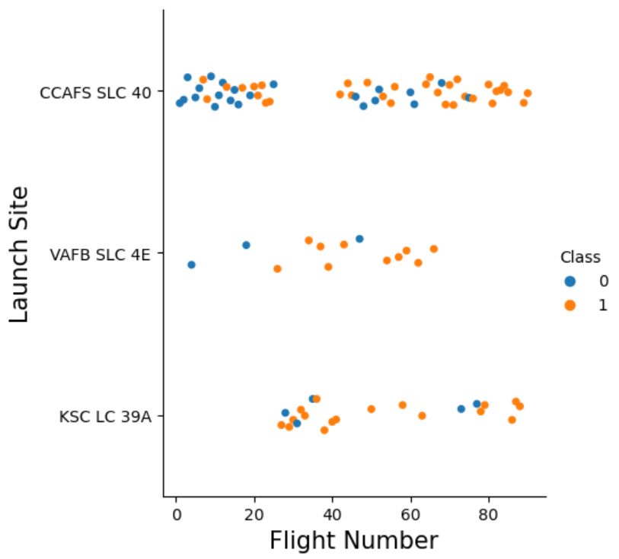

Flight Number vs. Launch Site
The CCAFS SLC 40 launch site records the most launches than the other sites

Slide 19
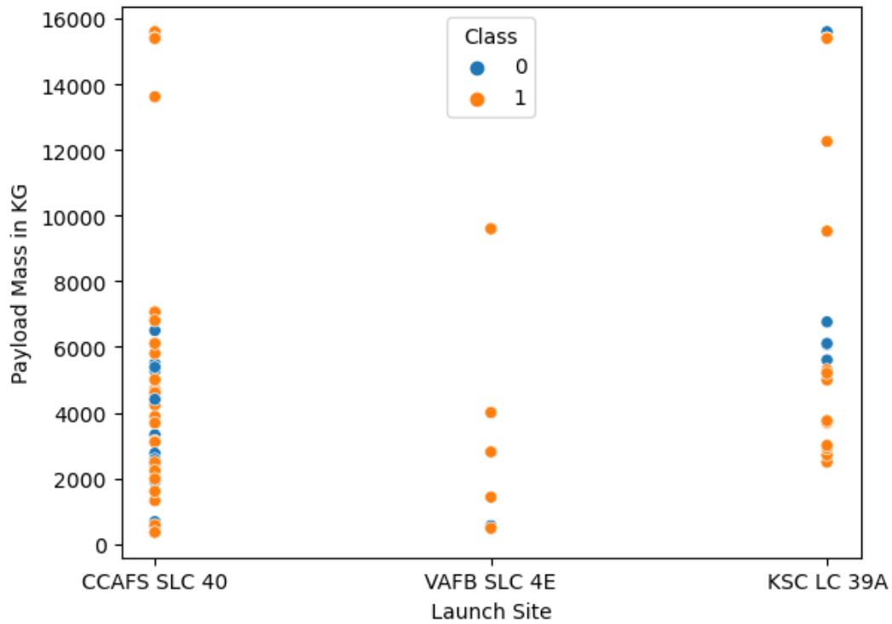
Payload vs. Launch Site
Most launch with lower Payload Mass launches has been done in the CCAFS SLC 40 launch site

Slide 20
Success Rate vs. Orbit Type
Missions on Orbit ES-L1,SSO,and HEO have the highest success rate

Slide 21
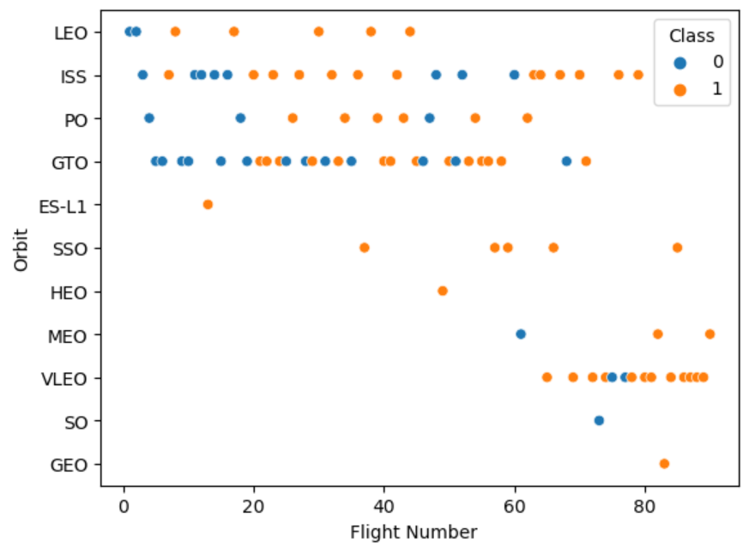
Flight Number vs. Orbit Type
even though the ISS and GTO Orbit record many launches, interest in the VLEO orbit can be observed recently

Slide 22
Payload vs. Orbit Type
There is a correlation between the Payload in the direction of the ISS and GTO orbits

Slide 23
Launch Success Yearly Trend
The success rate started increasing around 2013

Slide 24
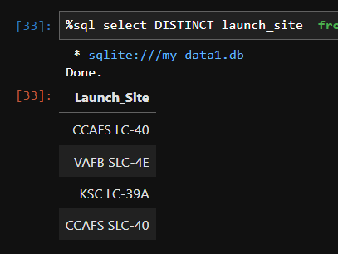
All Launch Site Names
%sql select * from SPACEXTBL
This SQL query command display the names of the unique launch sites in the space mission

Slide 25
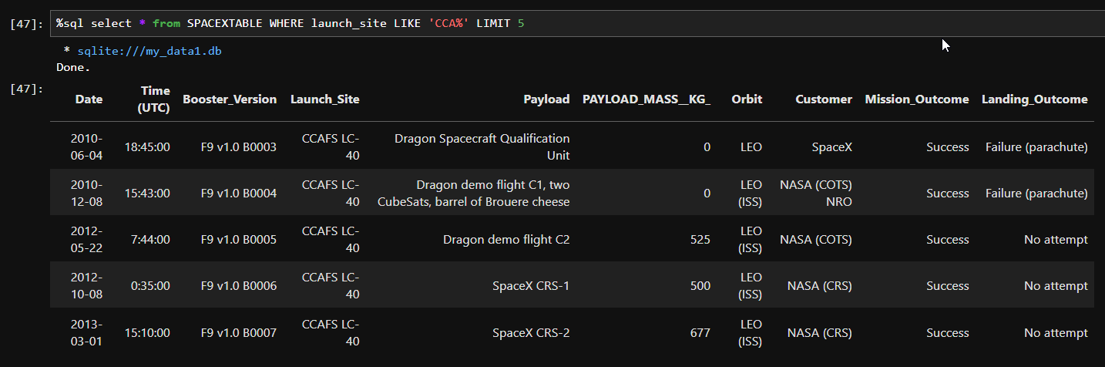
Launch Site Names Begin with 'CCA'
%sql select * from SPACEXTABLE WHERE launch_site LIKE 'CCA%' LIMIT 5
This SQL query command display 5 records where launch sites begin with the string 'CCA'

Slide 26
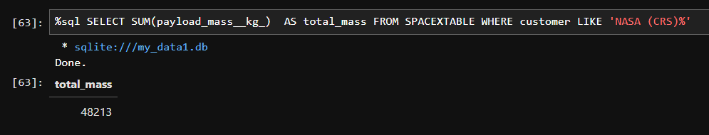
Total Payload Mass
%sql SELECT SUM(payload_mass__kg_) AS total_mass FROM SPACEXTABLE WHERE customer LIKE 'NASA (CRS)%’
This SQL query command display the total payload mass carried by boosters launched by NASA (CRS)

Slide 27
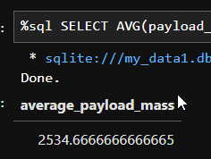
Average Payload Mass by F9 v1.1
%sql SELECT date from SPACEXTABLE WHERE mission_outcome LIKE 'Success%' AND landing_outcome LIKE 'Success (ground pad)%' ORDER BY date ASC
This SQL query command display the average payload mass carried by booster version F9 v1.1

Slide 28
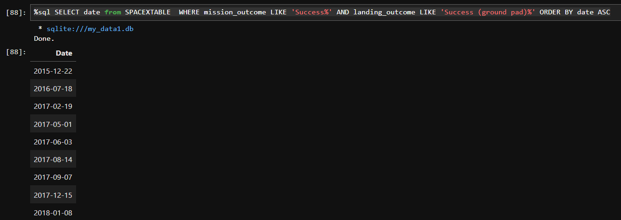
First Successful Ground Landing Date
%sql SELECT date from SPACEXTABLE WHERE mission_outcome LIKE 'Success%' AND landing_outcome LIKE 'Success (ground pad)%' ORDER BY date ASC
This SQL query command display the date when the first successful landing outcome in ground pad was achieved

Slide 29
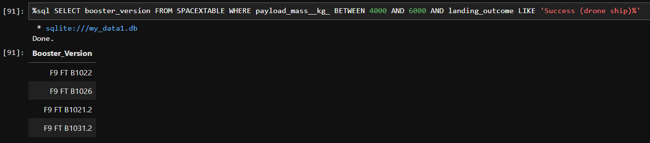
Successful Drone Ship Landing with Payload between 4000kg and 6000kG
%sql SELECT booster_version FROM SPACEXTABLE WHERE payload_mass__kg_ BETWEEN 4000 AND 6000 AND landing_outcome LIKE 'Success (drone ship)%'
This SQL query command display the names of the boosters which have success in drone ship and have payload mass greater than 4000 but less than 6000

Slide 30
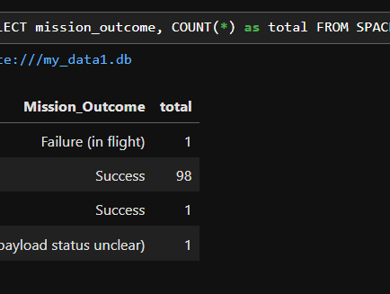
Total Number of Successful and Failure Mission Outcomes
%sql SELECT mission_outcome, COUNT(*) as total FROM SPACEXTBL GROUP by mission_outcome
This SQL query command display the total number of successful and failure mission outcomes

Slide 31
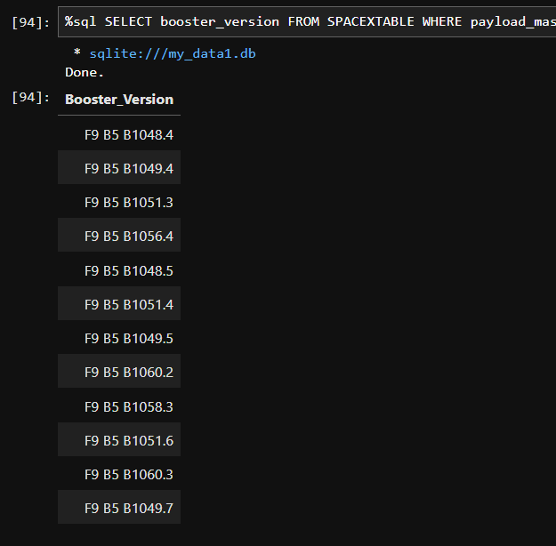
Boosters Carried Maximum Payload
%sql SELECT booster_version FROM SPACEXTABLE WHERE payload_mass__kg_ = (SELECT MAX(payload_mass__kg_) FROM SPACEXTABLE)
This SQL query command display the the names of the booster versions which have carried the maximum payload mass

Slide 32
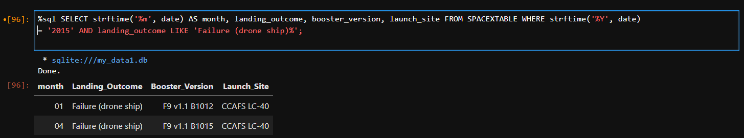
2015 Launch Records
%sql SELECT strftime('%m', date) AS month, landing_outcome, booster_version, launch_site FROM SPACEXTABLE WHERE strftime('%Y', date) = '2015' AND landing_outcome LIKE 'Failure (drone ship)%’;
This SQL query command list the records which will display the month names, failure landing outcomes in drone ship ,booster versions, launch site for the months in year 2015

Slide 33
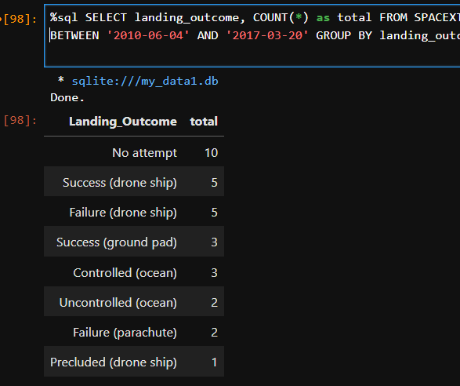
Rank Landing Outcomes Between 2010-06-04 and 2017-03-20
%sql SELECT landing_outcome, COUNT(*) as total FROM SPACEXTABLE WHERE date BETWEEN '2010-06-04' AND '2017-03-20' GROUP BY landing_outcome ORDER BY total DESC;
This SQL query command display the Rank the count of landing outcomes (such as Failure (drone ship) or Success (ground pad)) between the date 2010-06-04 and 2017-03-20, in descending order

Slide 34

Section 3

Slide 35
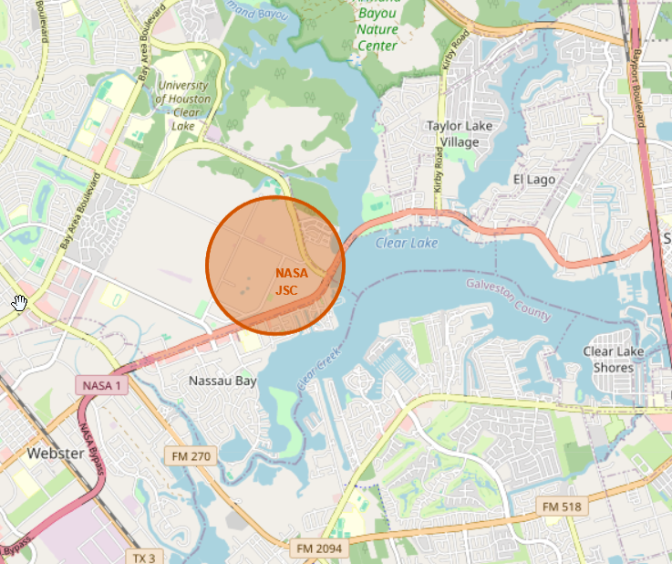
NASA Johnson Space Center at Houston, Texas.
NASA Johnson Space Center at Houston, Texas.

Slide 36
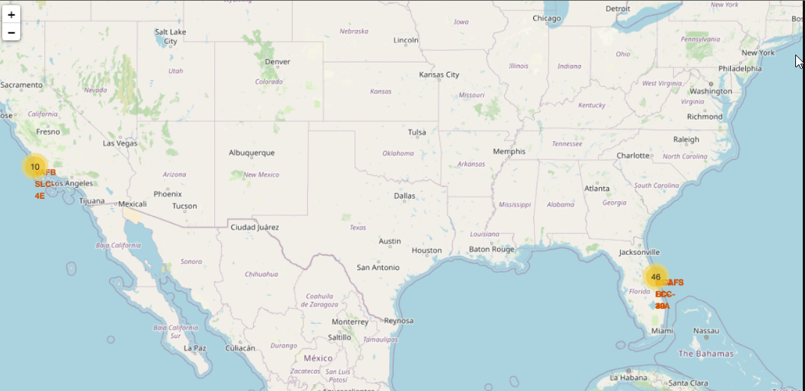
All Launch sites Market on a map
All Launch sites Market on a map

Slide 37
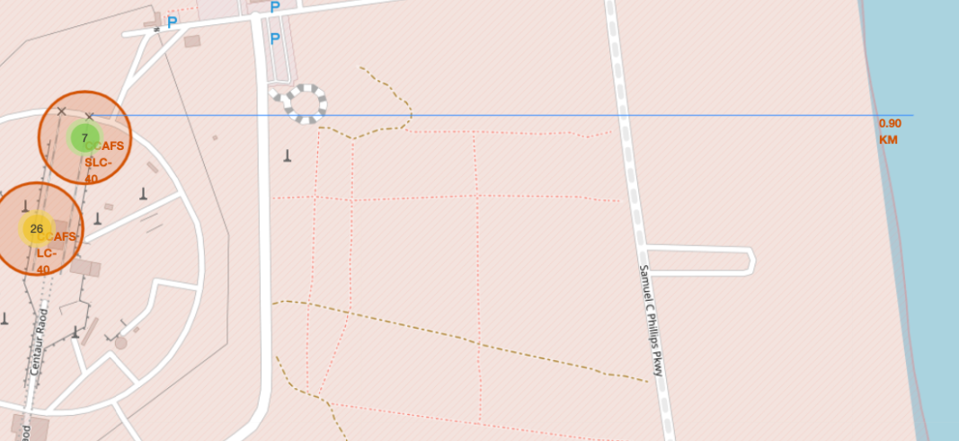
proximities such as railway, highway, coastline

Slide 38

Section 4

Slide 39
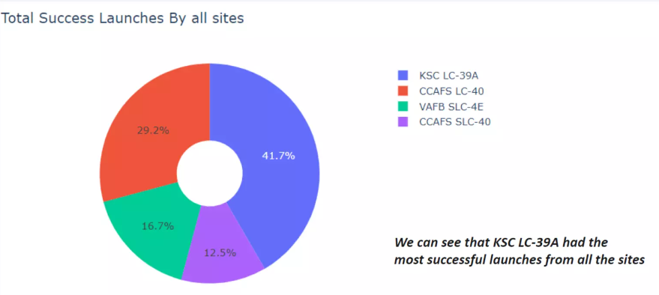
Total success launches by all sites

Slide 40
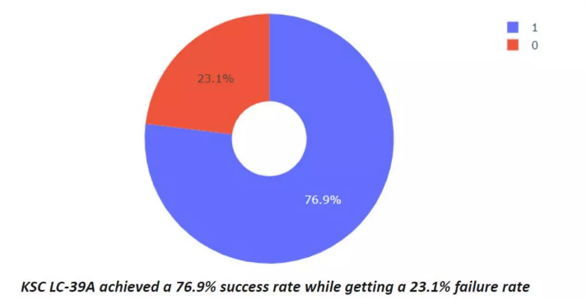
Succes rate by site

Slide 41
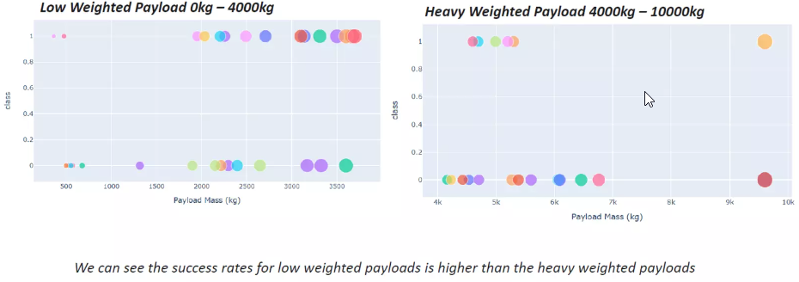
Payload vs launch outcome

Slide 42

Section 5

Slide 43
Classification Accuracy

Slide 44
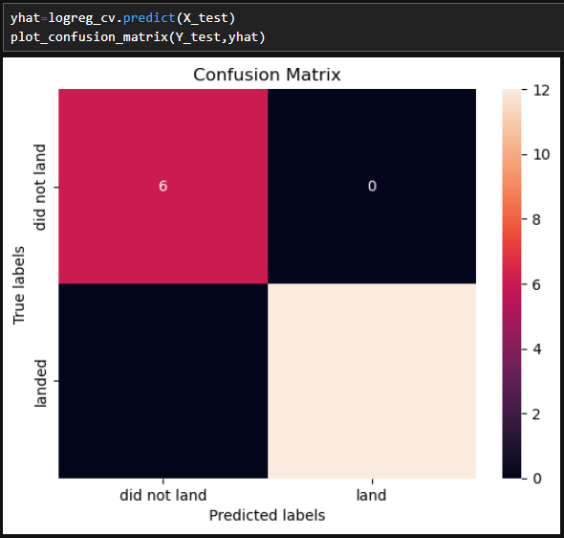
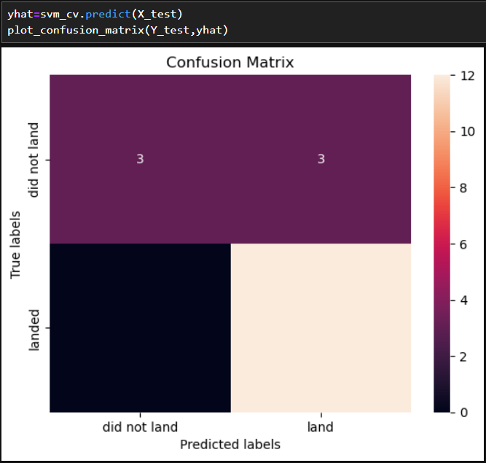
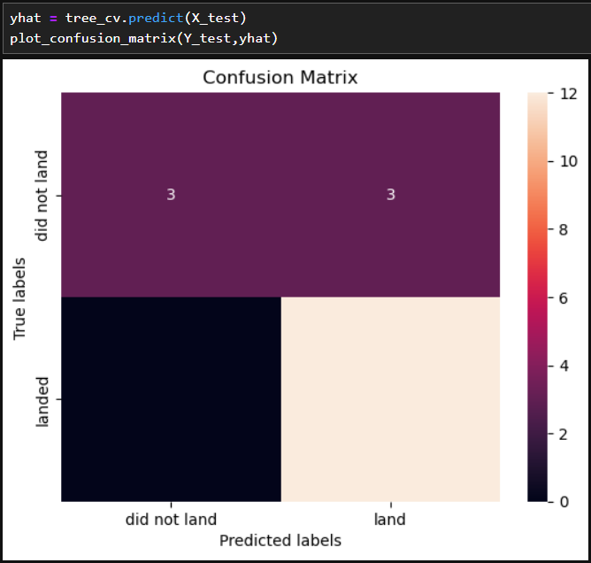
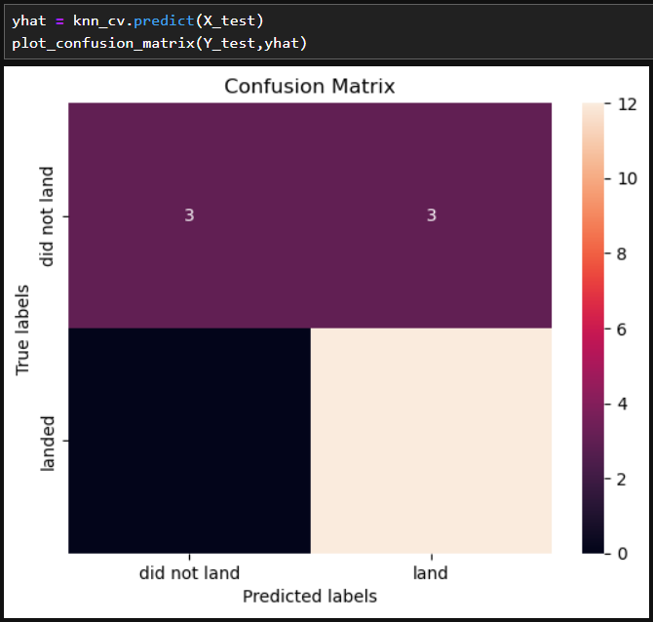
Confusion Matrix
Logistic Regression
SVM
Decision Tree Classification
KNN

Slide 45
SVM,KNN and logistic Regression model perform the best prediction accuracy on this dataset
Low weighted payloads perform better than the heavier payload
The success rates for SpaceX launches is directly proportional time in years they will eventually perfect the Launches
KSC LC 39A hat the most successful launches from all the sites
Orbit GEO,HEO,SSO,ES L1 has the best success rate
Conclusions

Slide 46
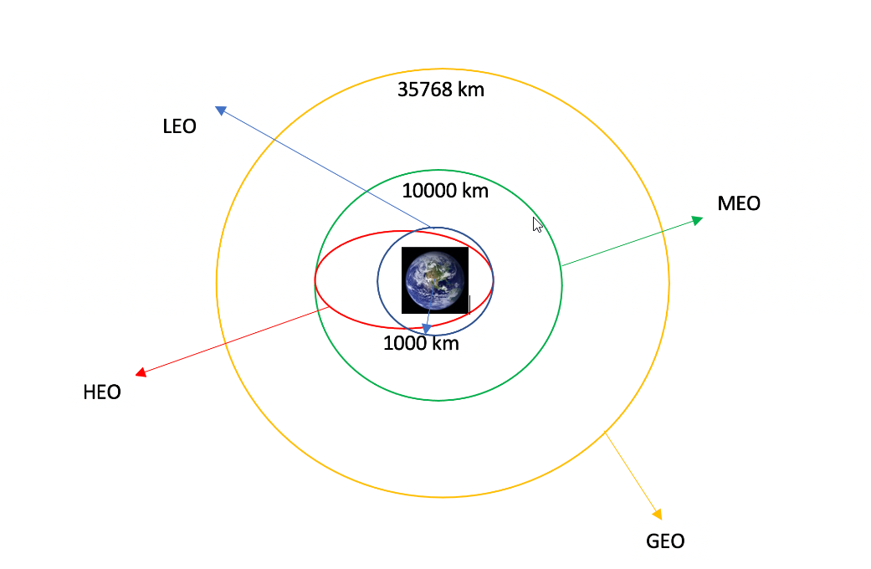
Appendix
ORBIT TYPE

Slide 47


